Slide 1
Kill-Death Classifier in a First-person Shooting Game
1
Presented To:
MD. JAFAR IQBAL
Managing Director & CEO,
Opus Technology Limited,
Dhaka, Bangladesh.
Presented By:
M. Mashrukh Zayed
MSc. Student is CSE, IUT-OIC
Home Address: Pabna Sadar, Pabna
Email: zayedmashrukh@ieee.org

Slide 2
Introduction
2
This classification task is specifically dependent on a video dataset which includes video-clips of kill and death scores from the first-person shooting game “CS Go”.
Videos can be understood as a series of individual images. We can treat video classification as performing image classification a total of N times, where N is the total number of frames in a video.
In this task, I have used ResNet-50 model for image classification and then turn it into a more accurate video classifier by employing rolling averaging method.
ResNet-50 is a convolutional neural network that is 50 layers deep.
I used rolling averaging method to avoid “prediction flickering”, which is a common problem for video classification. It is a prediction shifting problem between two predictions in a same video (one frame shows kill, other frame shows death, at the start of the video). It can easily be soled using rolling averaging method.

Slide 3
System Architecture
3
Extract all the frames from all videos
Load the images (frames) for training purpose, resize them to 224*224 dimension, default for ResNet-50
Generate trainable data from the image files and specify data labels using their directory name (kill/death)
Train the model by looping over all frames in the video files. Save the model in pickle format
Generate the model with ResNet-50 as base model, following with AveragePooling, Flatten, Dense, Dropout layers and ReLU activation in the middle, Softmax activation in the output
Divide the data into train data (75%) and test data (25%). Perform data augmentation on both of them
Create a test video by merging arbitrary kill and death videos from the dataset.
Obtain predictions. Use rolling averaging to choose the label with the largest corresponding probability between frames in a single video.
Label all the frames and write the output frames into an output video file

Slide 4
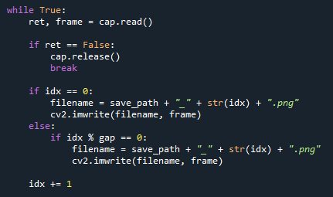
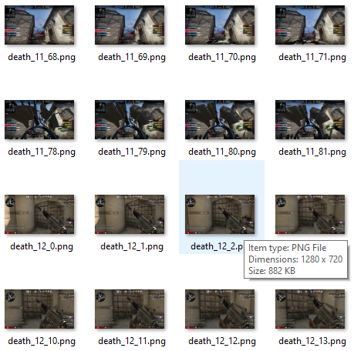
(1) Extract all the frames from all videos
4
Extracted all the frames from all the videos using a single code and saved them as frames.
Used the below portion to name the frames according to their video name and frame number.
Also kept option to extract the frames using any intervals (gap) I want.

Slide 5
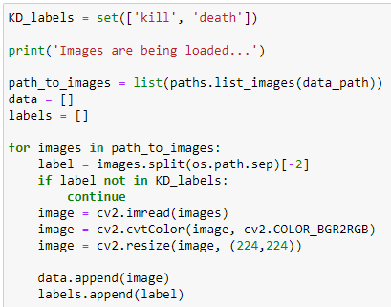
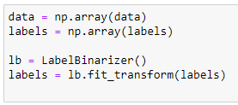
(2) Load Images, Resize (3) Define Label
5
Loaded frames from the “kill” and “directory”.
Defined the labels using the directory name.
Resized the images into 224×224 dimension.
Transformed the labels into binarized form (0,1).

Slide 6
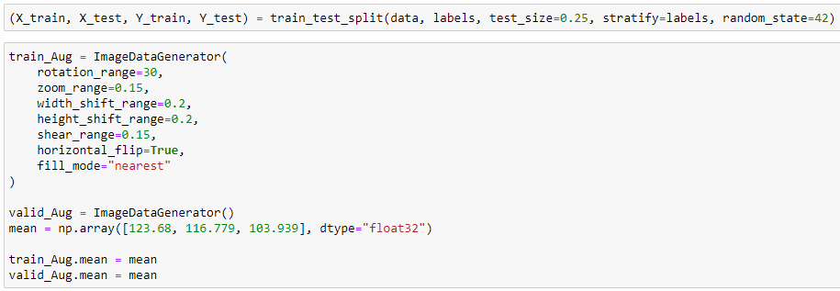
(4) Train-Test Split, Augmentation
6
25% data is used for testing, the rest is for training.
Performed data augmentation on both portion of the data.
Defined the mean subtraction (in RGB order) and set the mean subtraction value for each of the data augmentation.

Slide 7
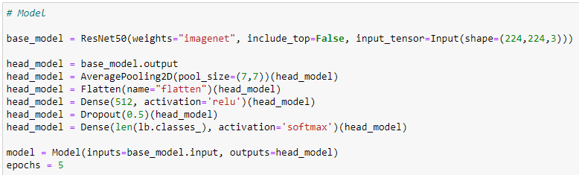
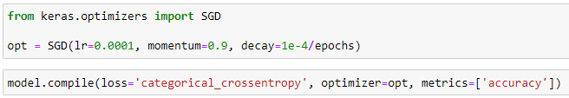
(5) Generate the model
7
ResNet50 architecture has 50 layers of CNN. I have added several other layers such as: AveragePooling2D with 77 pool-size, Flatten, Dense Layer with 512 neurons and ReLU activation, 50% Dropout
Used Softmax activation in the output layer, with number of classes defining the number of output neurons
Used categorical_crossentropy as loss function

Slide 8
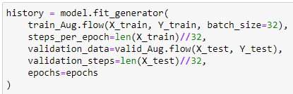
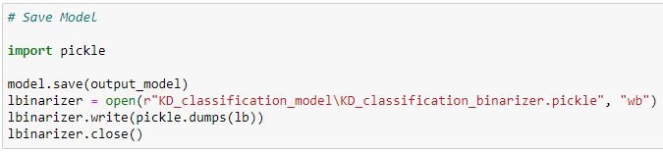
(6) Train the model & save
8
Trained the model with a batch size of 32, for steps dependent on the batch size also.
Used only 5 epochs considering the 2 days deadline for the task. A considerable number of more epochs surely can increase the performance.
Saved the trained model in pickle format.

Slide 9
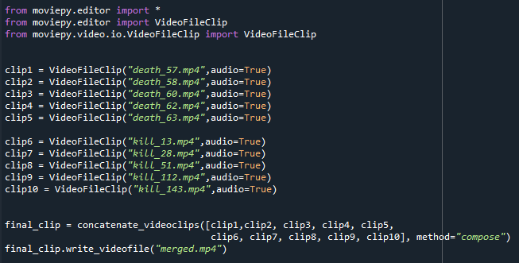
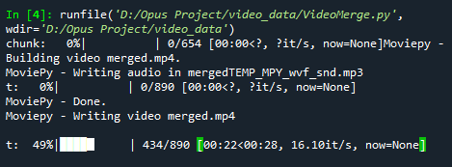
(7) Creating Test Video &
9
Chose 5 death and 5 kill videos for creating the test video.
The right-bottom figure shows the process of creating the merged video using “MoviePy” library.

Slide 10
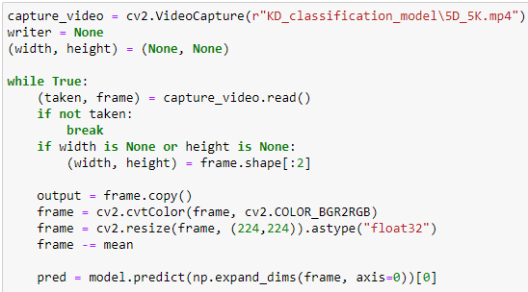

(8) Obtaining Prediction, Applying rolling averaging
10
Captured the video using cv2, read the frames and obtained label predictions on them individually.
Used rolling averaging to choose the label with the largest corresponding probability between frames in a single video.
The variable queue (bottom-right figure) keeps track of the prediction results and helps with choosing the label with highest probability.

Slide 11
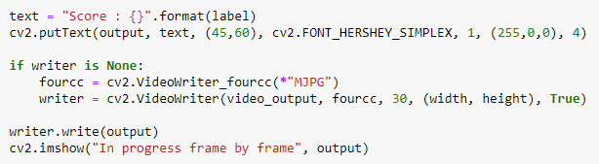
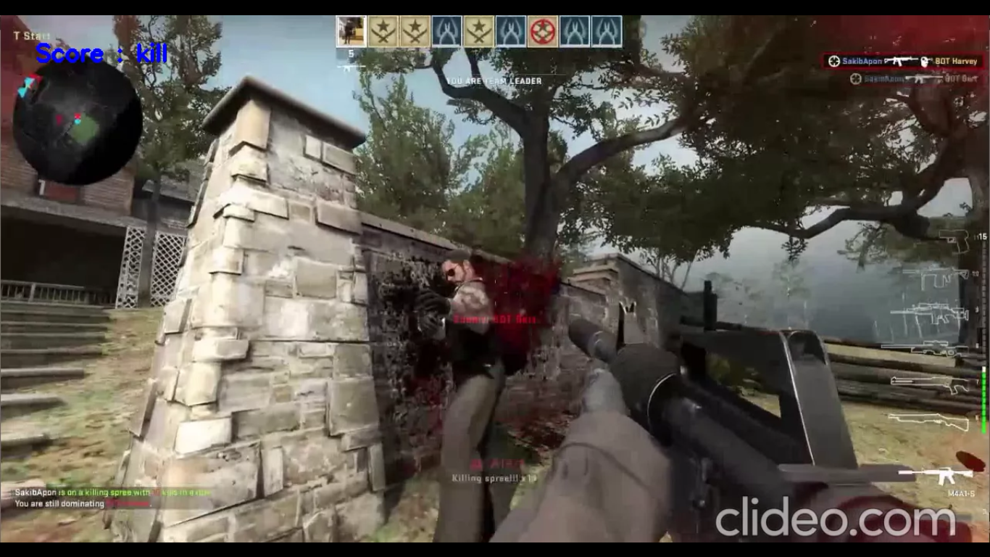
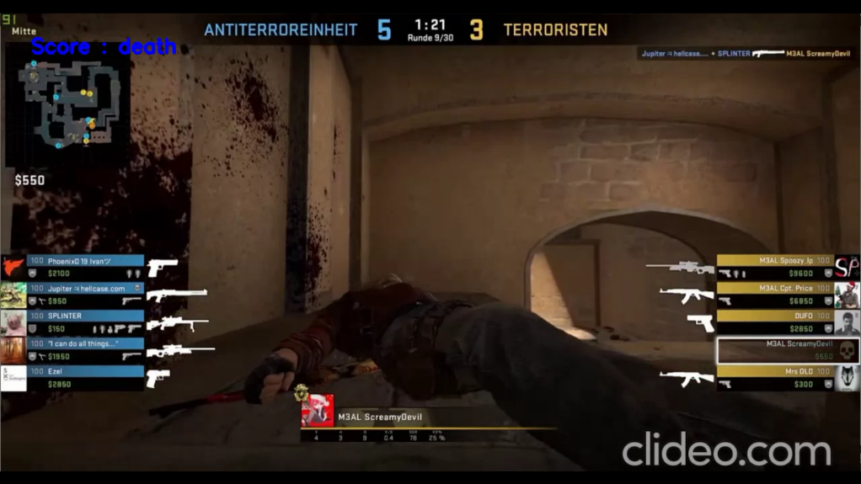
(9) Label the frames & generate an output video
11
Labeled each frame with the predicted action at top-left (blue text).
Displayed the progress frame by frame while processing.
Used all the output frames to generate an output video.

Slide 12
Thank you
12

